Slide 1

Spark Structured Streaming – basics
By: Dr Sachin Saxena

Slide 2
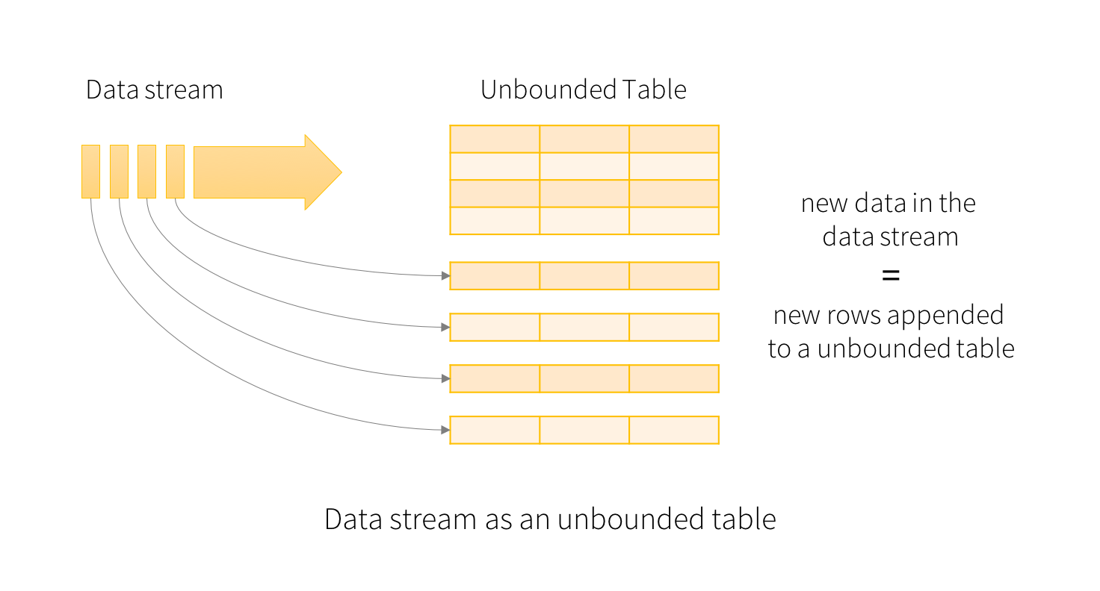

Slide 3
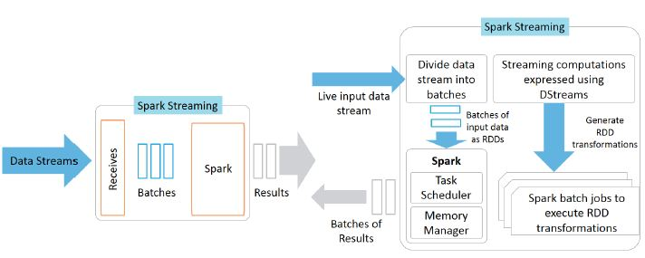

Slide 4
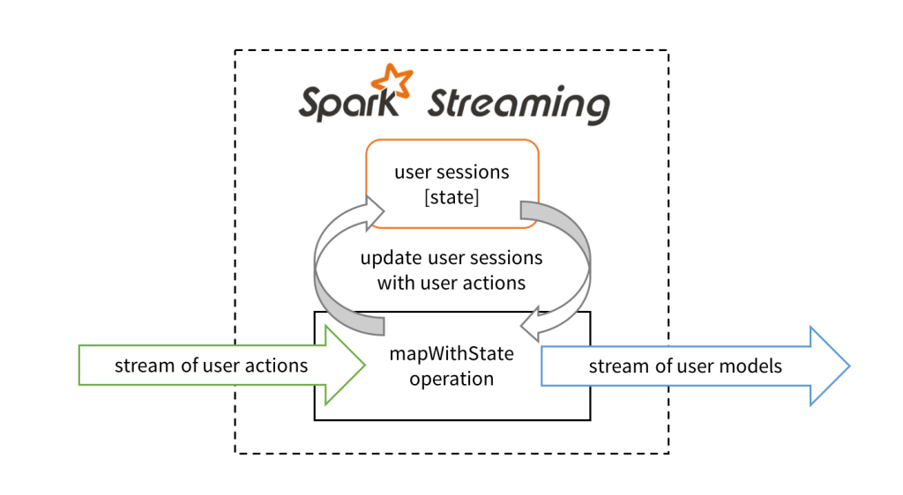

Slide 5
